Slide 1
Perceptron (neural) branch predictor
Daniel A. Jiménez
Slides adapted by: Dr Sparsh Mittal
Notes:
*
07/16/96
*
##

Slide 2
Conditional Branch Prediction is a
Machine Learning Problem
The machine learns to predict conditional branches
So why not apply a machine learning algorithm?
Artificial neural networks
  Simple model of neural networks in brain cells
  Learn to recognize and classify patterns
Idea: Use fast and accurate perceptrons [Rosenblatt `62, Block `62] for dynamic branch prediction

Slide 3
Input and Output of the Perceptron
The inputs to the perceptron are branch outcome histories
  Just like in 2-level adaptive branch prediction
  Can be global or local (per-branch) or both (alloyed)
  Conceptually, branch outcomes are represented as
    +1, for taken
    -1, for not taken
The output of the perceptron is
  Non-negative, if the branch is predicted taken
  Negative, if the branch is predicted not taken
Ideally, each static branch is allocated its own perceptron

Slide 4
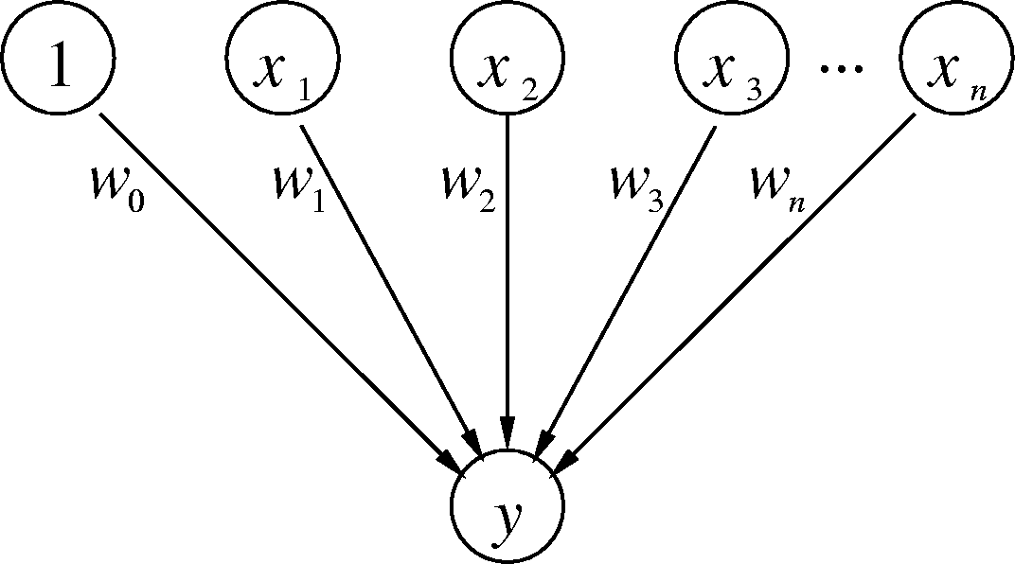
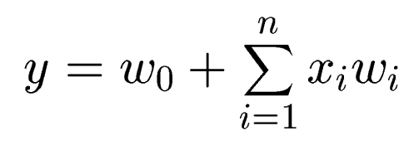
Branch-Predicting Perceptron
Inputs (x’s) are from branch history and are -1 or +1
n + 1 small integer weights (w’s) learned by on-line training
Output (y) is dot product of x’s and w’s; predict taken if y ≥ 0
Training finds correlations between history and outcome

Slide 5
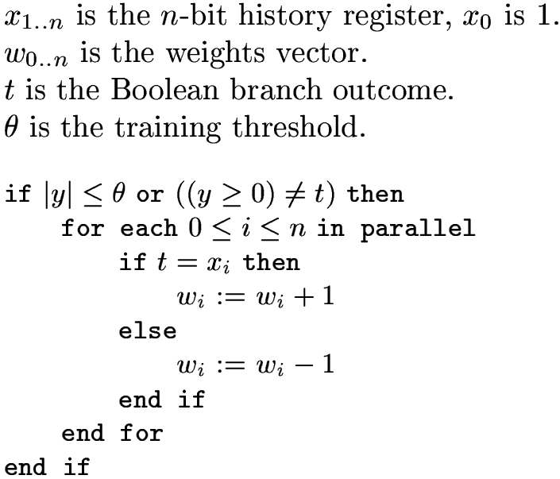
Training Algorithm
For our course, we ignore this condition => we will always retrain the predictor after each prediction

Slide 6
What Do The Weights Mean?
The bias weight, w₀:
  Proportional to the probability that the branch is taken
  Doesn’t take into account other branches; just like a Smith predictor
The correlating weights, w₁ through w_{n}:
  w_{i} is proportional to the probability that the predicted branch agrees with the i^{th} branch in the history
The dot product of the w’s and x’s
  w_{i} × x_{i} is proportional to the probability that the predicted branch is taken based on the correlation between this branch and the i^{th} branch
  Sum takes into account all estimated probabilities
What’s θ?
  Keeps from overtraining; adapt quickly to changing behavior

Slide 7
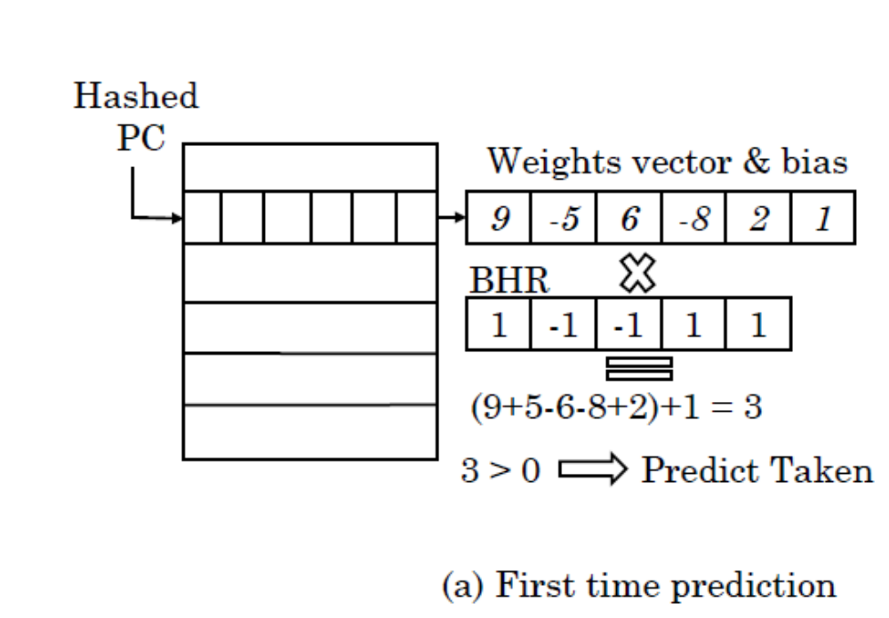
Example: (1 of 3)

Slide 8
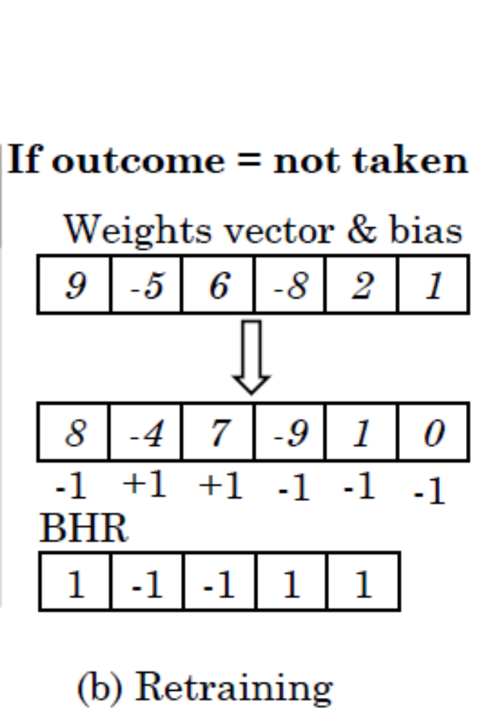
Example: (2 of 3)

Slide 9
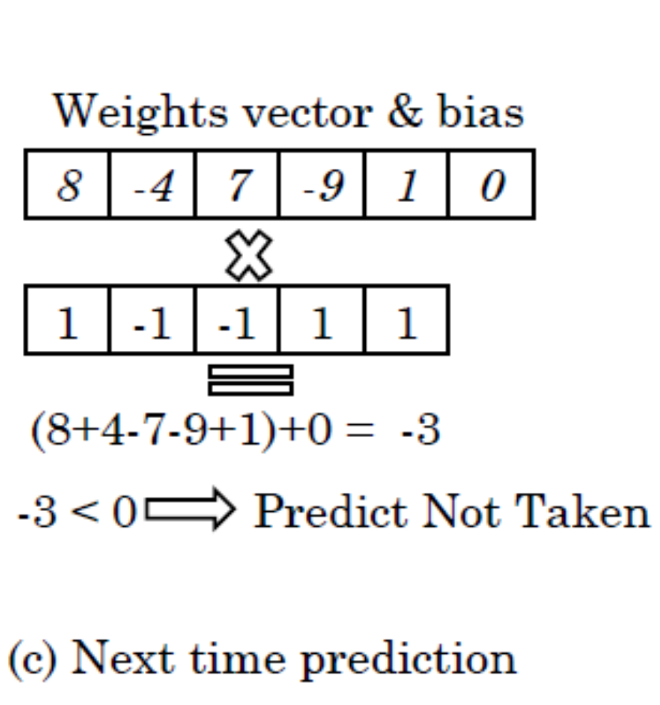
Example: (3 of 3)

Slide 10


Mathematical Intuition
A perceptron defines a hyperplane in n+1-dimensional space:
For instance, in 2D space we have:
This is the equation of a line, the same as

Slide 11
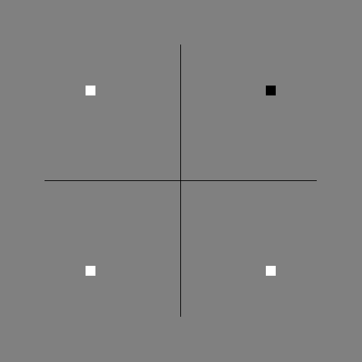
Example: AND
Here is a representation of the AND function
White means false, black means true for the output
-1 means false, +1 means true for the input
-1 AND -1 = false
-1 AND +1 = false
+1 AND -1 = false
+1 AND +1 = true

Slide 12
Program to Compute AND
int f () {
int a, b, x, i, s = 0;
for (i=0; i<100; i++) {
a = rand () % 2;
b = rand () % 2;
if (a) {
if (b)
x = 1;
else
x = 0;
} else {
if (b)
x = 0;
else
x = 0;
}
if (x) s++; /* this is the branch */
}
return s;
}

Slide 13
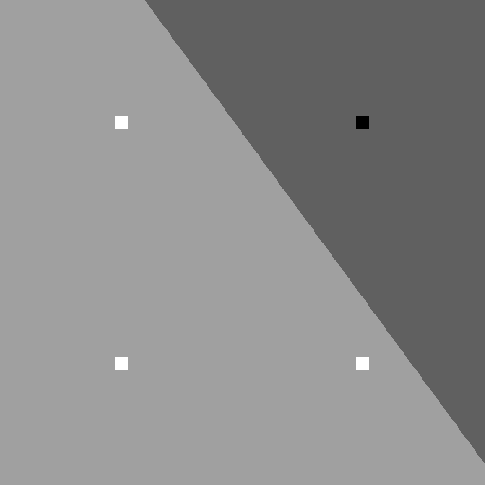
Example: AND continued
A linear decision surface (i.e. a plane in 3D space) intersecting the feature space (i.e. the 2D plane where z=0) separates false from true instances

Slide 14
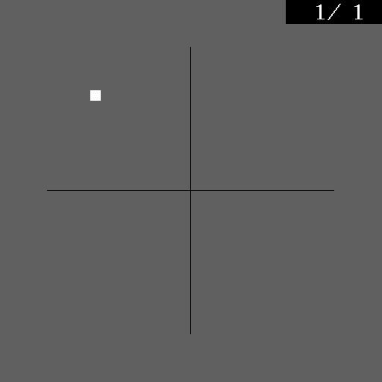
Example: AND continued
Watch a perceptron learn the AND function:

Slide 15
Program to Compute XOR
int f () {
int a, b, x, i, s = 0;
for (i=0; i<100; i++) {
a = rand () % 2;
b = rand () % 2;
if (a) {
if (b)
x = 0;
else
x = 1;
} else {
if (b)
x = 1;
else
x = 0;
}
if (x) s++; /* this is the branch */
}
return s;
}

Slide 16
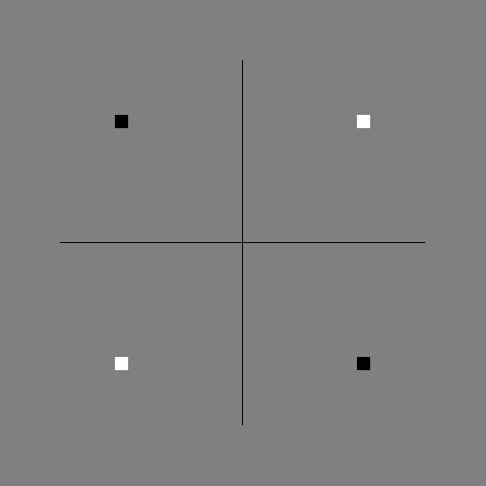
Example: XOR
Here’s the XOR function:
-1 XOR -1 = false
-1 XOR +1 = true
+1 XOR -1 = true
+1 XOR +1 = false
Perceptrons cannot learn such linearly inseparable functions

Slide 17
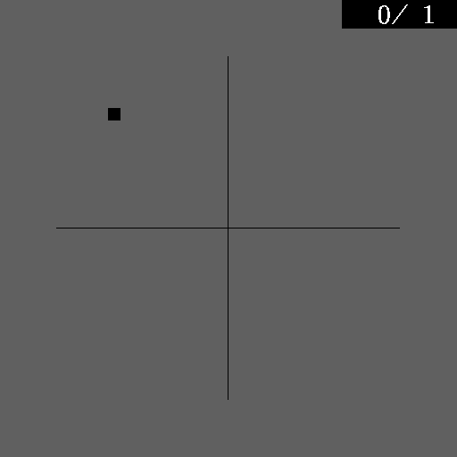
Example: XOR continued
Watch a perceptron try to learn XOR

Slide 18
Concluding Remarks
Perceptron is an alternative to traditional branch predictors
Provides high accuracy
Limitations:
  Latency
  Linear inseparability

Slide 19
Idealized Piecewise Linear
Branch Prediction
Daniel A. Jiménez
This and subsequent slides are not part of CS2323 course.
They are included just for illustration.
Notes:
*
07/16/96
*
##

Slide 20
Previous Neural Predictors
The perceptron predictor uses only pattern history information
  The same weights vector is used for every prediction of a static branch
  The i^{th} history bit could come from any number of static branches
  So the i^{th} correlating weight is aliased among many branches
The newer path-based neural predictor uses path information
  The i^{th} correlating weight is selected using the i^{th} branch address
  This allows the predictor to be pipelined, mitigating latency
  This strategy improves accuracy because of path information
  But there is now even more aliasing since the i^{th} weight could be used to predict many different branches

Slide 21
Piecewise Linear Branch Prediction
Generalization of perceptron and path-based neural predictors

Slide 22
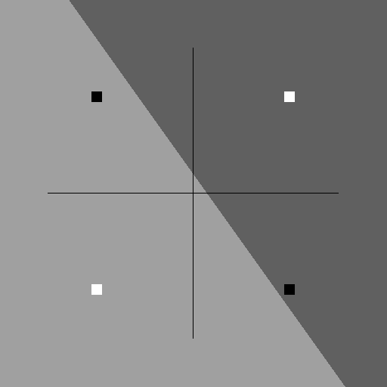
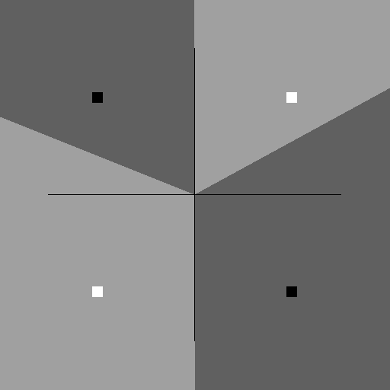
Why It’s Better
Forms a piecewise linear decision surface
  Each piece determined by the path to the predicted branch
Can solve more problems than perceptron
Perceptron decision surface for XOR
doesn’t classify all inputs correctly
Piecewise linear decision surface for XOR
classifies all inputs correctly

Slide 23
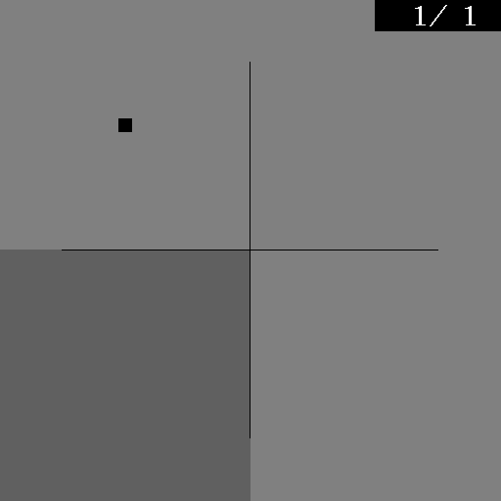
Learning XOR
From a program that computes XOR using if statements
perceptron prediction
piecewise linear prediction

